Slide 1
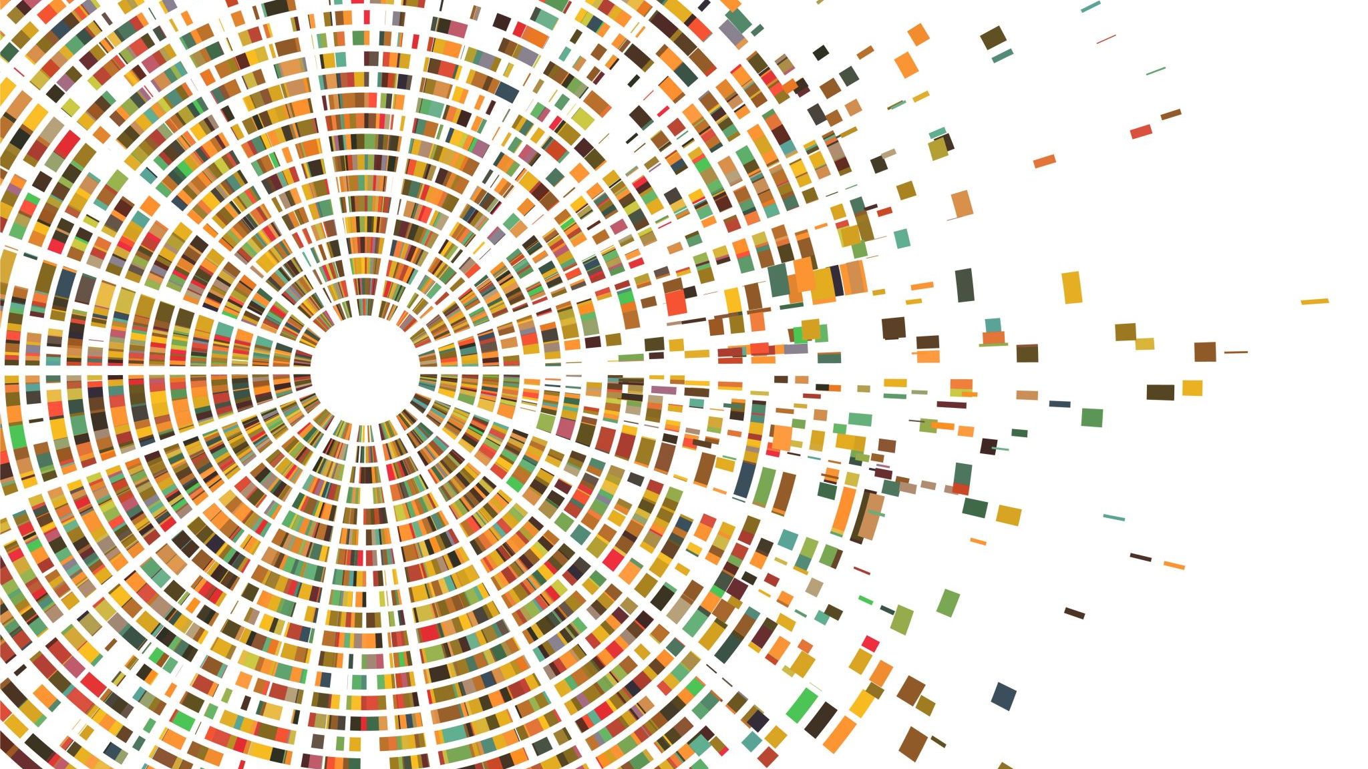
Functions and Modular Code
Lecture 11

Slide 2
Introduction to Function
What is a function?
A block of reusable code that performs a specific task
Helps make programs modular and easier to maintain
Why use functions?
Reduces code repetition
Improves readability and debugging
Enables collaboration (modular development)

Slide 3

Defining a Function in Python
def keyword to define a function
Function name: greet
No parameters in this case
print("Hello, world!") is the function body
Try It: Define a function called say_hello() that prints your name.

Slide 4

Calling a Function
Once a function is defined, you call it like this:
Think of calling a function like pressing a button - it runs the task it was designed to do.

Slide 5


Functions with Parameters
Parameters act as placeholders for inputs
You provide arguments when calling the function:
Activity: Write a function welcome(name, age) to print a welcome message using both inputs.

Slide 6


Returning Values from Functions
Use return to send a result back

Slide 7
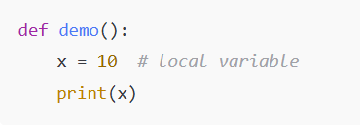
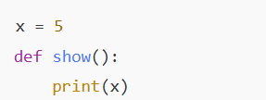
Scope of Variables
Local Scope: Only available inside the function
Global Scope: Declared outside functions, accessible everywhere

Slide 8
Modular Programming
Modular programming is a software design technique that promotes breaking down a program into smaller, self-contained modules or functions.
Each module or function should have a specific purpose and should ideally perform a single task.

Slide 9
Modular Programming
Advantages of modular programming:
Reusability: You can reuse functions/modules in different parts of your program or even in other programs.
Maintainability: Smaller modules are easier to understand, test, and maintain than large monolithic code.
Collaboration: Multiple programmers can work on different modules simultaneously.
In Python, you can create modular programs by defining functions, classes, or even separate Python files (modules) that you import into your main program.

Slide 10
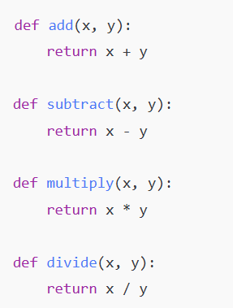

Example – Calculator Program
Call the functions:

Slide 11
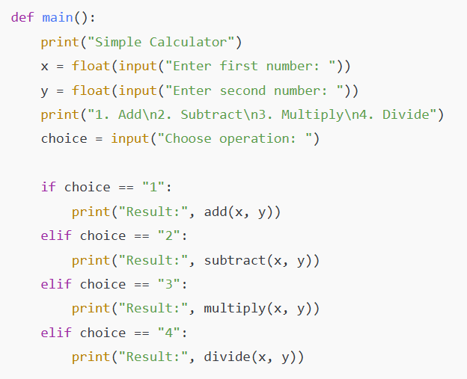
Main Program (Calculator with Menu)

Slide 12
Summary
Functions improve code structure and reusability
Use def, parameters, and return to build flexible functions
Understand variable scope to avoid errors
Modular design = easier debugging, testing, teamwork

Slide 13
Practice Tasks
Write a function to check if a number is even or odd.
Create a modular program to calculate area of square, rectangle, and triangle.
Extend the calculator to handle invalid inputs.

